Slide 1



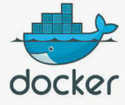


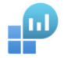
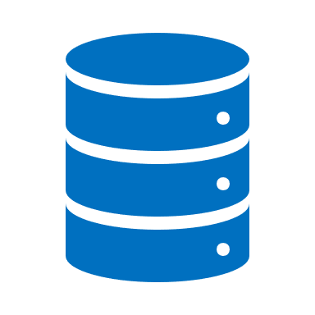



Containerized model deployment
Workload types
Online
Development
Call
API
ACS
AKS
LOGS
Retrieved model deployment
Orchestrate job
Batch
(Airflow)
Data
source
Azure
Data
bricks
MLFlow
tracking

